Slide 1
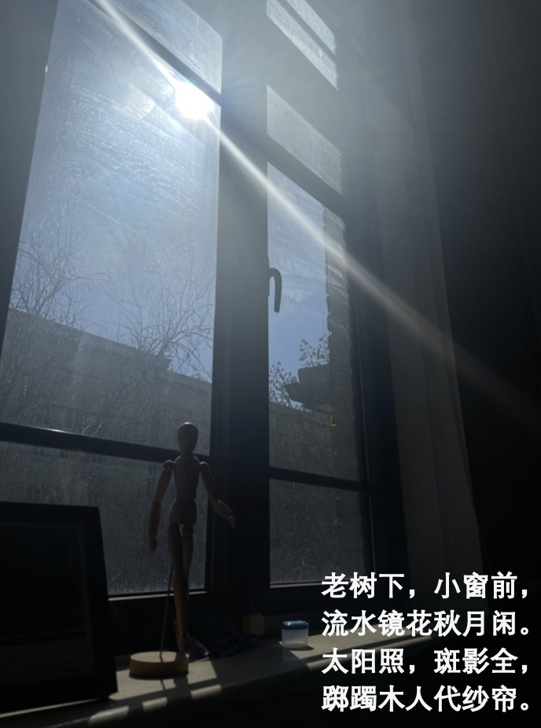
热物（第六、七周）
化学势一
热力学关系和等式
化学势二
Gibbs Sum

Slide 2
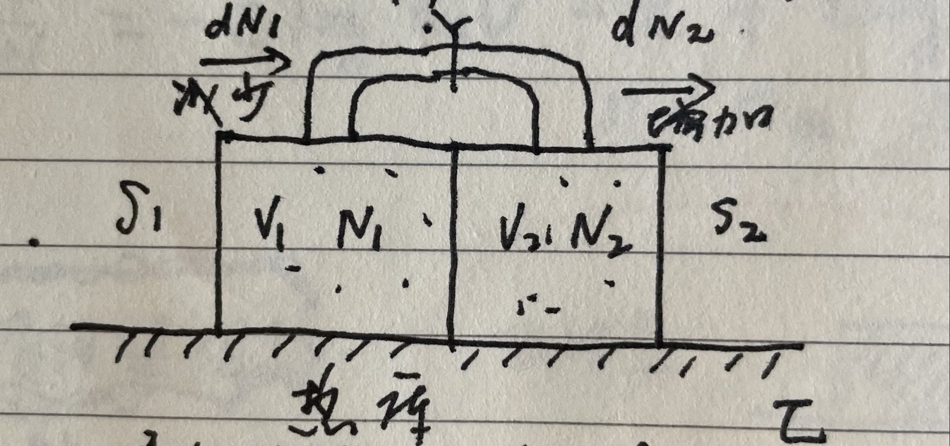
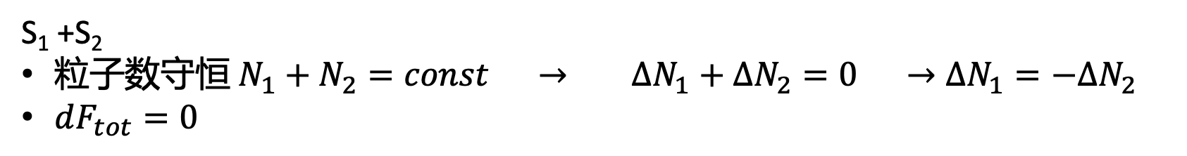
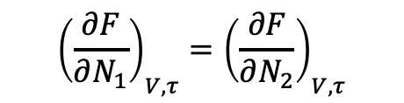
定义化学势！！！
S₁ +S₂
粒子数守恒 $N_{1}+N_{2}=const → ∆N_{1}+∆N_{2}=0 →∆N_{1}=−∆N_{2}$
$dF_{tot}=0$
$$\frac{∂F}{∂N_{1}} dN_{1}+\frac{∂F}{∂N_{2}}dN_{2}=0$$
$${\left(\frac{∂F}{∂N_{1}}\right)}_{V,τ}={\left(\frac{∂F}{∂N_{2}}\right)}_{V,τ}$$

Slide 3
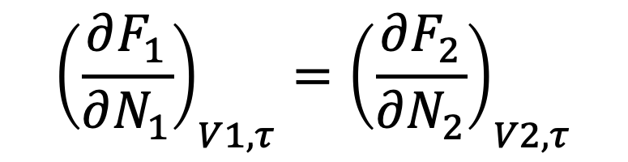

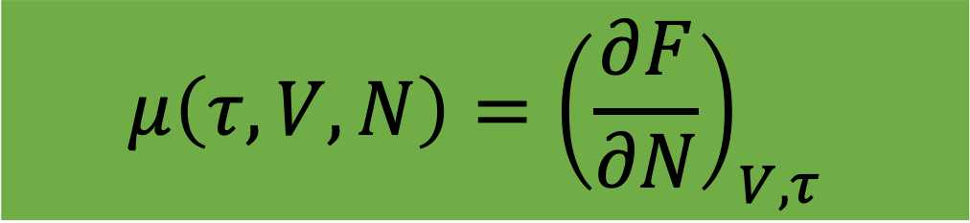
引入近似：粒子交换很弱（但大到可以交换），不改变各自状态，可独立计算
$$F≈F_{1}+F_{2}$$
回忆一下以前的近似（热接触、缓慢压缩）
$${\left(\frac{∂F_{1}}{∂N_{1}}\right)}_{V1,τ}={\left(\frac{∂F_{2}}{∂N_{2}}\right)}_{V2,τ}$$
扩散平衡条件
Diffusive Equilibrium
化学势（chemical potential）
$$μ_{1}=μ_{2}$$
$$μ\left(τ,V,N\right)={\left(\frac{∂F}{∂N}\right)}_{V,τ}$$

Slide 4
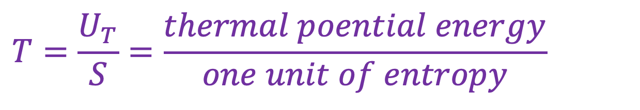
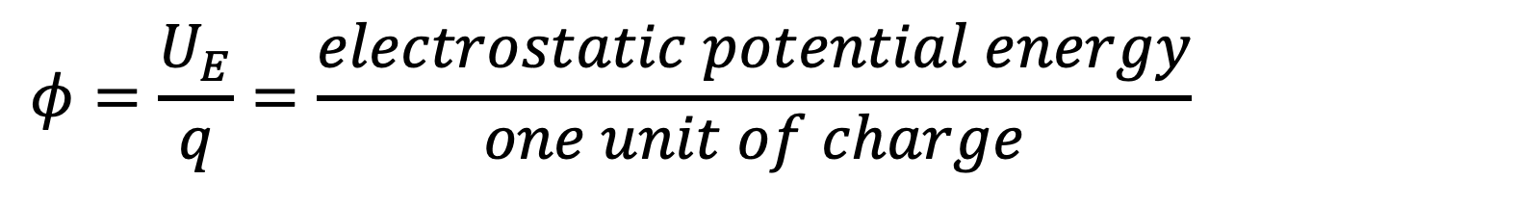
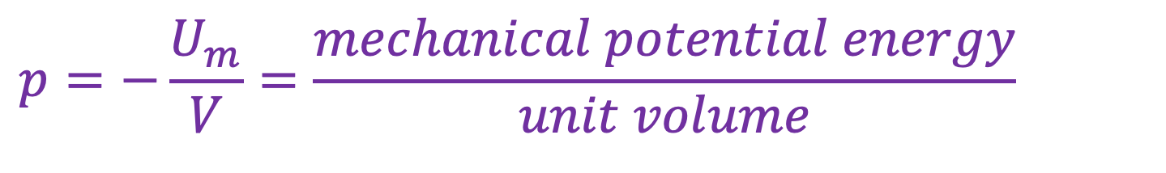
Potential: A potential in physics is defined as the energy stored per unit of matter(potential energy intensity)
$$φ=\frac{U_{E}}{q}=\frac{electrostatic potential energy}{one unit of charge}$$
Particles tend to flow from the system with higher mu into the system with lower mu.
$$T=\frac{U_{T}}{S}=\frac{thermal poential energy}{one unit of entropy}$$
$$p=−\frac{U_{m}}{V}=\frac{mechanical potential energy}{unit volume}$$

Slide 5
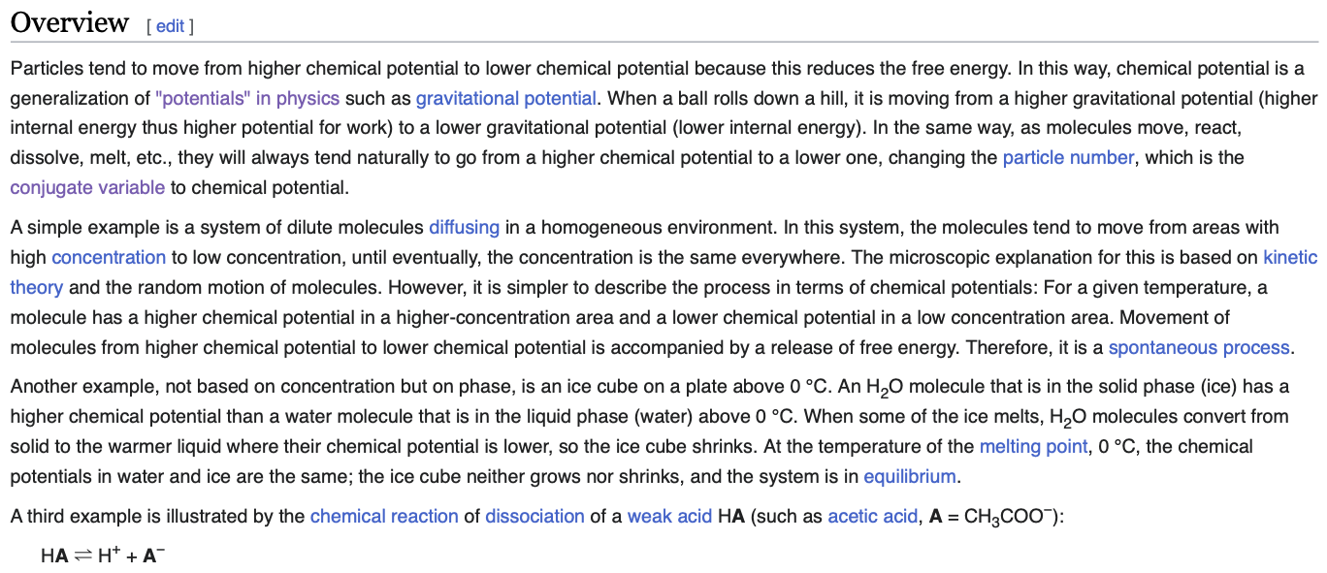

Slide 6
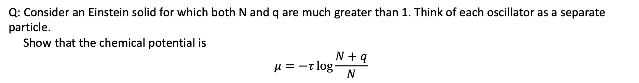
Q: Consider an Einstein solid for which both N and q are much greater than 1. Think of each oscillator as a separate particle.
Show that the chemical potential is
$$μ=−τ\log{\frac{N+q}{N}}$$
是否可以从自由能出发得到答案呢？

Slide 7
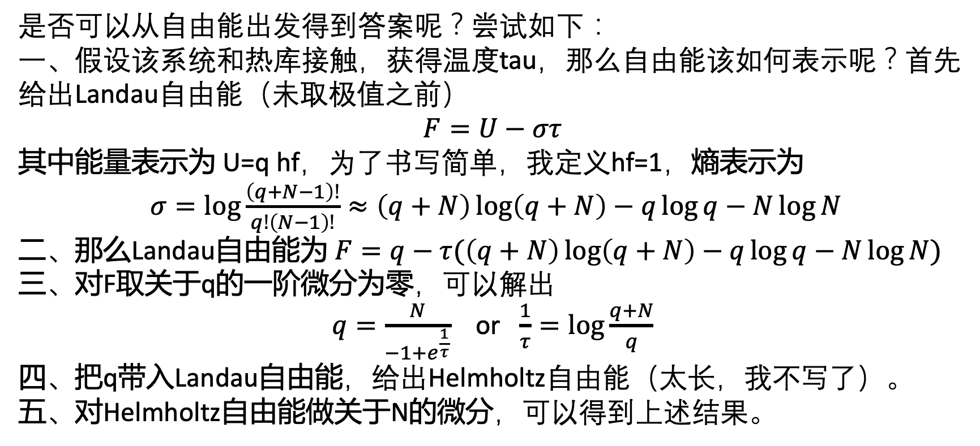
Q: Consider an Einstein solid for which both N and q are much greater than 1. Think of each oscillator as a separate particle.
Show that the chemical potential is
$$μ=−τ\log{\frac{N+q}{N}}$$
是否可以从自由能出发得到答案呢？尝试如下：
一、假设该系统和热库接触，获得温度tau，那么自由能该如何表示呢？首先给出Landau自由能（未取极值之前）
$$F=U−στ$$
其中能量表示为 U=q hf，为了书写简单，我定义hf=1，熵表示为
$σ=\log{\frac{\left(q+N−1\right)!}{q!\left(N−1\right)!}}≈\left(q+N\right)\log\left(q+N\right)−q\log{q−N\log{N}}$
二、那么Landau自由能为 $F=q−τ(\left(q+N\right)\log\left(q+N\right)−q\log{q−N\log{N}})$
三、对F取关于q的一阶微分为零，可以解出
$q=\frac{N}{−1+e^{\frac{1}{τ}}}$ or $\frac{1}{τ}=\log{\frac{q+N}{q}}$
四、把q带入Landau自由能，给出Helmholtz自由能（太长，我不写了）。
五、对Helmholtz自由能做关于N的微分，可以得到上述结果。

Slide 8
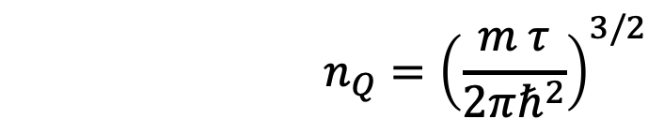
$$n_{Q}={\left(\frac{m τ}{2πℏ^{2}}\right)}^{3/2}$$
理想气体的化学势

Slide 9
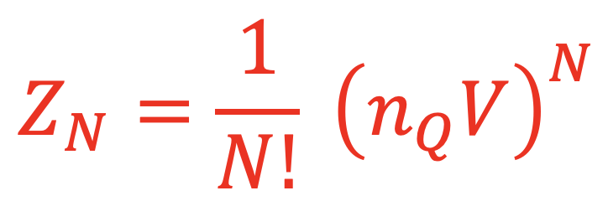
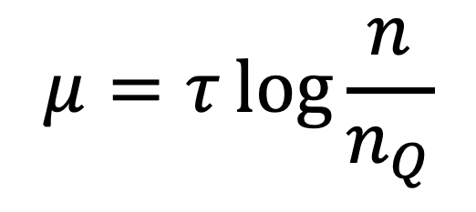
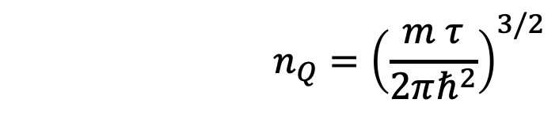
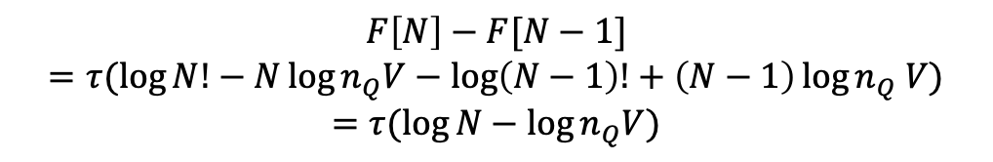
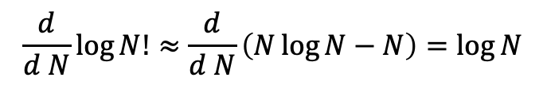
理想气体的化学势
$$F[N]=τ(\log{N!}−N\log{n_{Q}V})$$
$$n_{Q}={\left(\frac{m τ}{2πℏ^{2}}\right)}^{3/2}$$
$$F\left[N\right]−F[N−1]$$
$$=τ(\log{N!−N\log{n_{Q}V}−\log\left(N−1\right)!+\left(N−1\right)\log{n_{Q} V}})$$
$$=τ(\log{N−\log{n_{Q}V}})$$
$$\frac{d}{d N}\log{N!≈\frac{d}{d N}\left(N\log{N−N}\right)=\log{N}}$$
$$μ=τ\log{\frac{n}{n_{Q}}}$$

Slide 10

$$n_{Q}={\left(\frac{m τ}{2πℏ^{2}}\right)}^{3/2}$$
理想气体的化学势
$$F[N]=τ(\log{N!}−N\log{n_{Q}V})$$
$$F\left[N\right]−F[N−1]$$
$$=τ(\log{N!−N\log{n_{Q}V}−\log\left(N−1\right)!+\left(N−1\right)\log{n_{Q} V}})$$
$$=τ(\log{N−\log{n_{Q}V}})$$
$$\frac{d}{d N}\log{N!≈\frac{d}{d N}\left(N\log{N−N}\right)=\log{N}}$$
$$μ=τ\log{\frac{n}{n_{Q}}}$$
有问题吗？

Slide 11
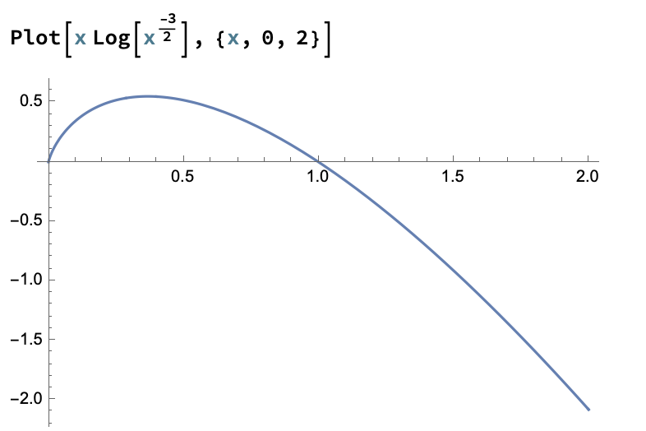
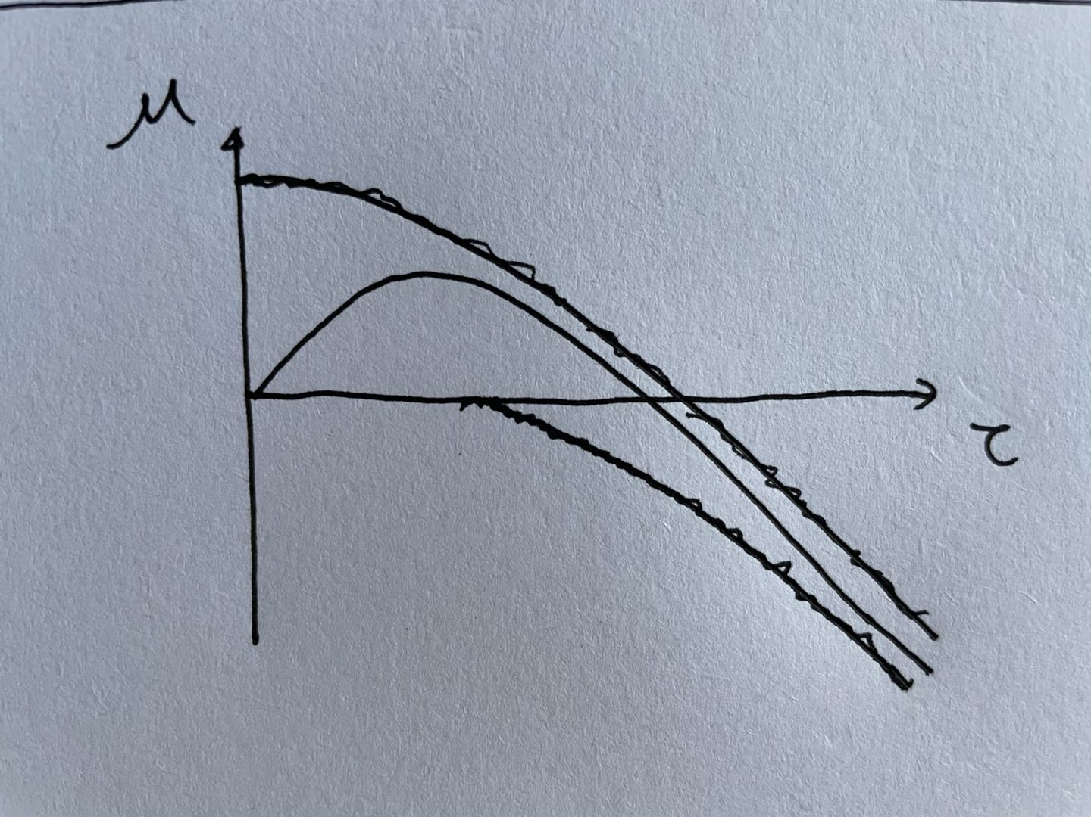
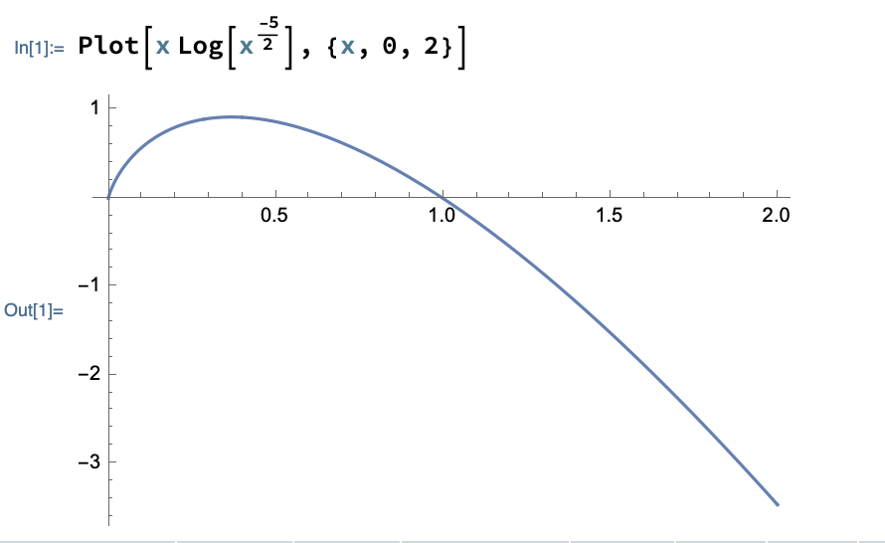

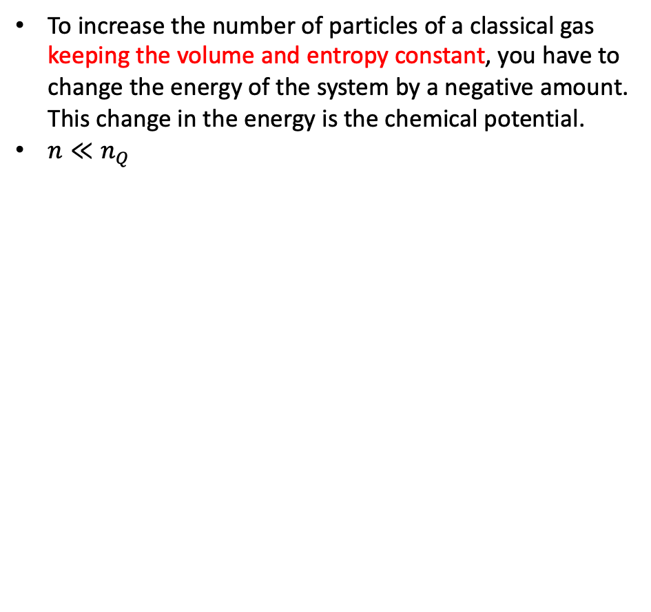
$$μ=τ\log{\frac{n}{n_{Q}}}$$
To increase the number of particles of a classical gas keeping the volume and entropy constant, you have to change the energy of the system by a negative amount. This change in the energy is the chemical potential.
$n≪n_{Q}$
问题一

Slide 12
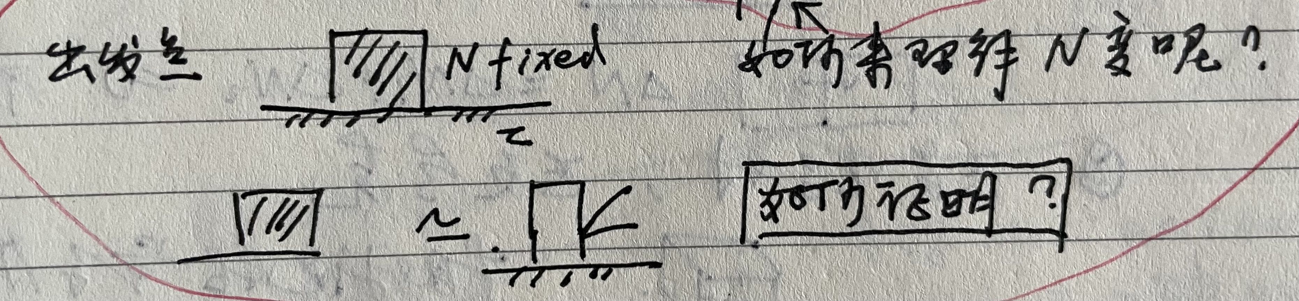
问题二

Slide 13
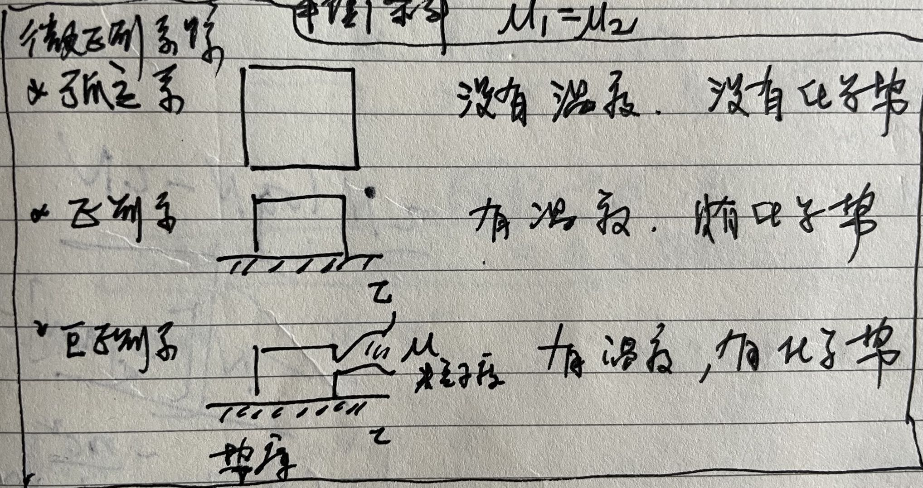
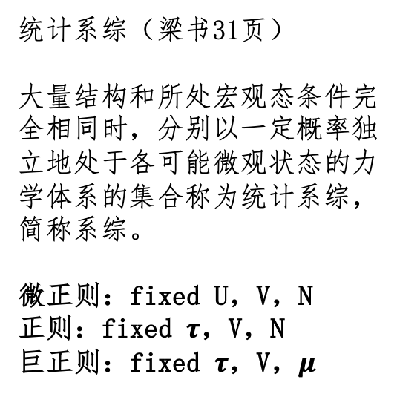
统计系综（梁书31页）
大量结构和所处宏观态条件完全相同时，分别以一定概率独立地处于各可能微观状态的力学体系的集合称为统计系综，简称系综。
微正则：fixed U，V，N
正则：fixed $τ$，V，N
巨正则：fixed $τ$，V，$μ$

Slide 14
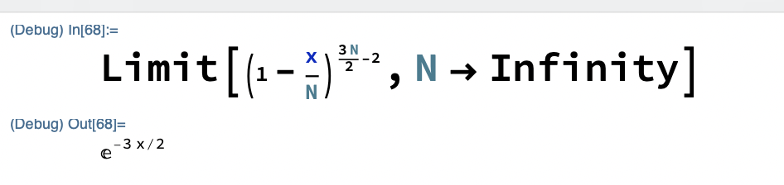
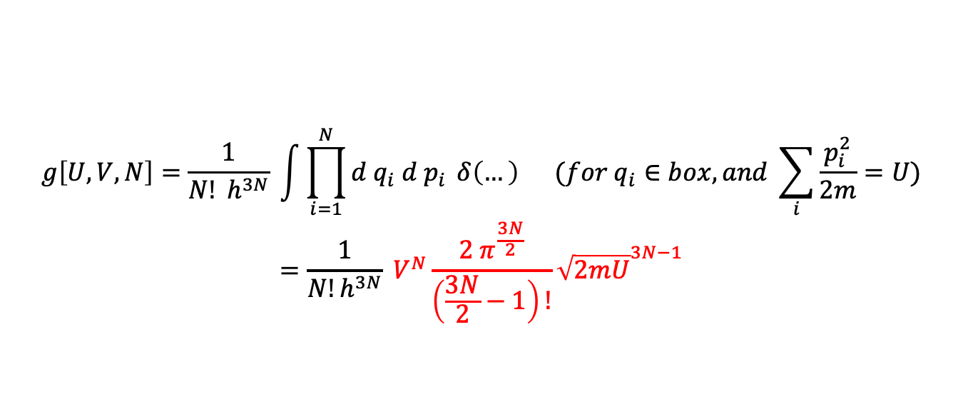
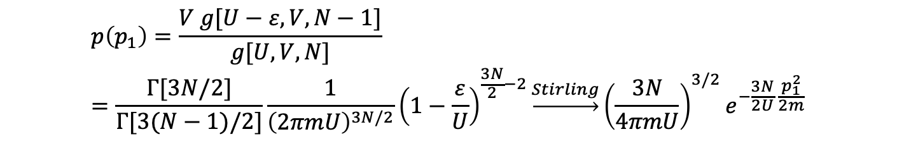
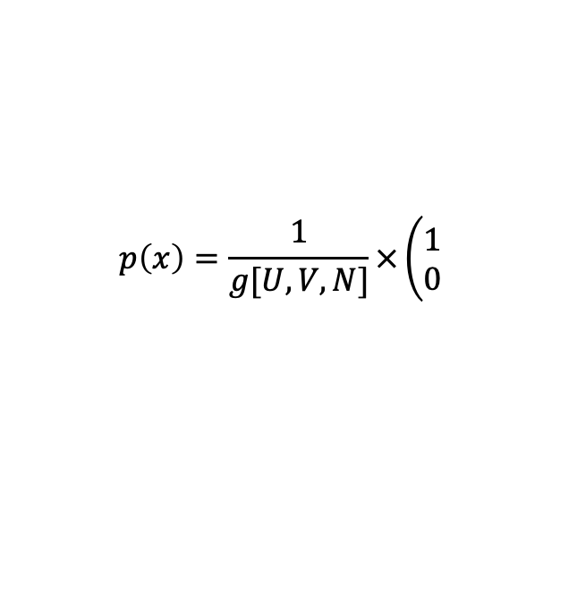
微正则系综（U，V，N）
$$g\left[U,V,N\right]=\frac{1}{N! h^{3N}} \int{\prod_{i=1}^{N}{d q_{i} d p_{i}} δ\left(…\right) (for q_{i}∈box, and \sum_{i}{\frac{p_{i}^{2}}{2m}=U})}$$
$$=\frac{1}{N!h^{3N}} V^{N}\frac{2 π^{\frac{3N}{2}}}{\left(\frac{3N}{2}−1\right)!}{\sqrt{2mU}}^{3N−1}$$
$$p\left(x\right)=\frac{1}{g[U,V,N]}×\left(\begin{matrix}1 \\ 0\end{matrix}\right.$$
The unconditional probability of finding a particle of momentum p1 in the gas
$$p\left(p_{1}\right)=\frac{V g[U−ε,V,N−1]}{g[U,V,N]}=\frac{Γ[3N/2]}{Γ[3(N−1)/2]}\frac{1}{{\left(2πmU\right)}^{3N/2}}{\left(1−\frac{ε}{U}\right)}^{\frac{3N}{2}−2}\underset{→}{Stirling}{\left(\frac{3N}{4πmU}\right)}^{3/2}e^{−\frac{3N}{2U} \frac{p_{1}^{2}}{2m}}$$

Slide 15
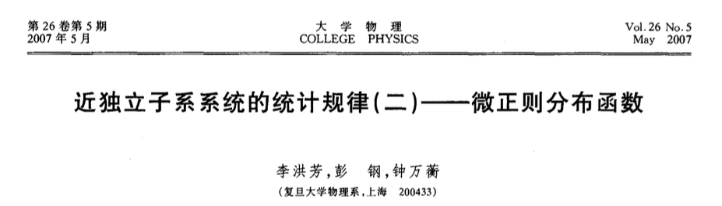
微正则系综（U，V，N）
$$g\left[U,V,N\right]=\frac{1}{N! h^{3N}} \int{\prod_{i=1}^{N}{d q_{i} d p_{i}} δ\left(…\right) (for q_{i}∈box, and \sum_{i}{\frac{p_{i}^{2}}{2m}=U})}$$
$$=\frac{1}{N!h^{3N}} V^{N}\frac{2 π^{\frac{3N}{2}}}{\left(\frac{3N}{2}−1\right)!}{\sqrt{2mU}}^{3N−1}$$
$$p\left(x\right)=\frac{1}{g[U,V,N]}×\left(\begin{matrix}1 \\ 0\end{matrix}\right.$$
The unconditional probability of finding a particle of momentum p1 in the gas
$$p\left(p_{1}\right)=\frac{V g[U−ε,V,N−1]}{g[U,V,N]}=\frac{Γ[3N/2]}{Γ[3(N−1)/2]}\frac{1}{{\left(2πmU\right)}^{3N/2}}{\left(1−\frac{ε}{U}\right)}^{\frac{3N}{2}−2}\underset{→}{Stirling}{\left(\frac{3N}{4πmU}\right)}^{3/2}e^{−\frac{3N}{2U} \frac{p_{1}^{2}}{2m}}$$

Slide 16

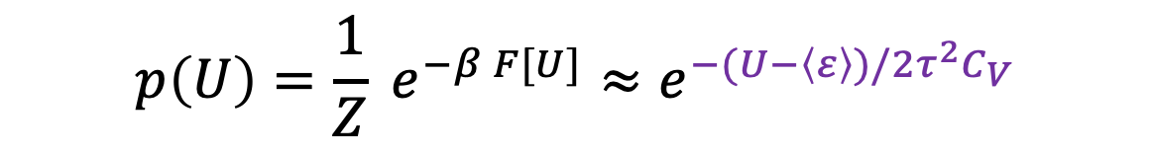
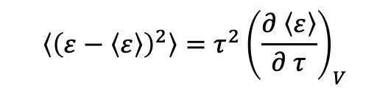
正则系综（$τ$，V，N）
$$\left\langle {\left(ε−\left\langle ε\right\rangle \right)}^{2}\right\rangle =τ^{2}{\left(\frac{∂ \left\langle ε\right\rangle }{∂ τ}\right)}_{V}$$
$$p\left[U\right]=\frac{1}{Z}e^{−F/τ}$$
The probability of p[U] is sharply peaked at a most probable energy U*, which minimizes F.
$$p\left(U\right)=\frac{1}{Z} e^{−β F[U]}≈e^{−(U−\left\langle ε\right\rangle )/2τ^{2}C_{V}}$$
For any finite system, the canonical and microcanonical probabilities are distinct. However, in the so called thermodynamic limit of N → ∞ limit, the canonical probabilities are so sharply peaked around the average energy that they are essentially indistinct from microcanonical probabilities at that energy.
巨正则？？？（给一个信心，后面再讨论之）

Slide 17
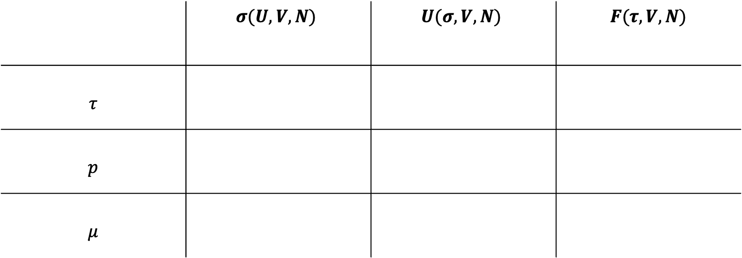
热力学关系
 | $$σ(U,V,N)$$ | $$U(σ,V,N)$$ | $$F(τ,V,N)$$
$$τ$$
$$p$$
$$μ$$

Slide 18
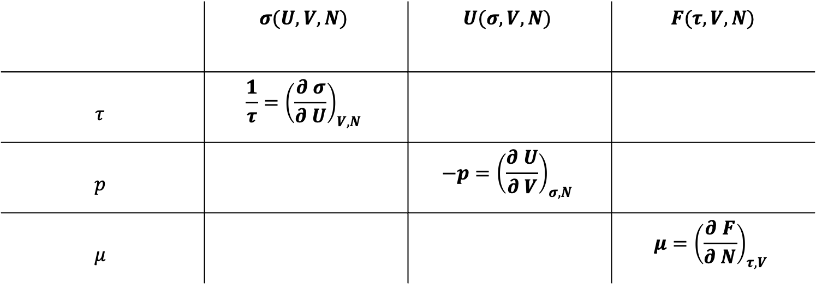
热力学关系
 | $$σ(U,V,N)$$ | $$U(σ,V,N)$$ | $$F(τ,V,N)$$
$$τ$$ | $$\frac{1}{τ}={\left(\frac{∂ σ}{∂ U}\right)}_{V,N}$$
$$p$$ |  | $$−p={\left(\frac{∂ U}{∂ V}\right)}_{σ,N}$$
$$μ$$ |  |  | $$μ={\left(\frac{∂ F}{∂ N}\right)}_{τ,V}$$

Slide 19
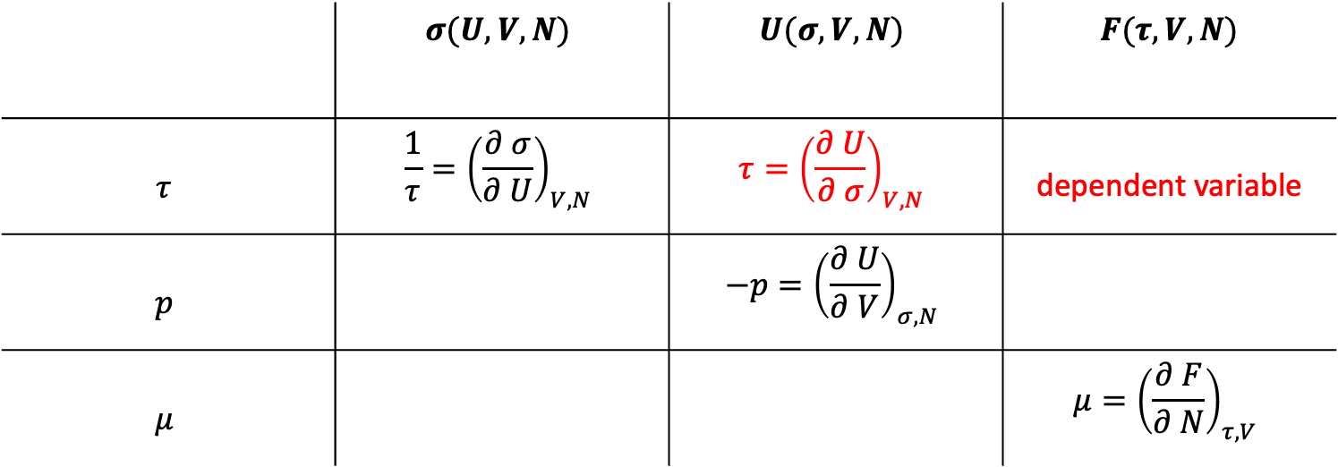
 | $$σ(U,V,N)$$ | $$U(σ,V,N)$$ | $$F(τ,V,N)$$
$$τ$$ | $$\frac{1}{τ}={\left(\frac{∂ σ}{∂ U}\right)}_{V,N}$$ | $$τ={\left(\frac{∂ U}{∂ σ}\right)}_{V,N}$$ | dependent variable
$$p$$ |  | $$−p={\left(\frac{∂ U}{∂ V}\right)}_{σ,N}$$
$$μ$$ |  |  | $$μ={\left(\frac{∂ F}{∂ N}\right)}_{τ,V}$$

Slide 20

 | $$σ(U,V,N)$$ | $$U(σ,V,N)$$ | $$F(τ,V,N)$$
$$τ$$ | $$\frac{1}{τ}={\left(\frac{∂ σ}{∂ U}\right)}_{V,N}$$ | $$τ={\left(\frac{∂ U}{∂ σ}\right)}_{V,N}$$ | dependent variable
$$p$$ | ？ | $$−p={\left(\frac{∂ U}{∂ V}\right)}_{σ,N}$$ | $$？$$
$$μ$$ | ? | ? | $$μ={\left(\frac{∂ F}{∂ N}\right)}_{τ,V}$$

Slide 21
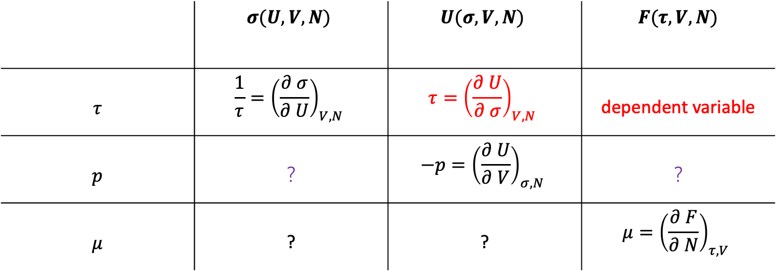
 | $$σ(U,V,N)$$ | $$U(σ,V,N)$$ | $$F(τ,V,N)$$
$$τ$$ | $$\frac{1}{τ}={\left(\frac{∂ σ}{∂ U}\right)}_{V,N}$$ | $$τ={\left(\frac{∂ U}{∂ σ}\right)}_{V,N}$$ | dependent variable
$$p$$ | $$？$$ | $$−p={\left(\frac{∂ U}{∂ V}\right)}_{σ,N}$$ | $$？$$
$$μ$$ | ? | ? | $$μ={\left(\frac{∂ F}{∂ N}\right)}_{τ,V}$$
思路
Step-II
Step-I

Slide 22
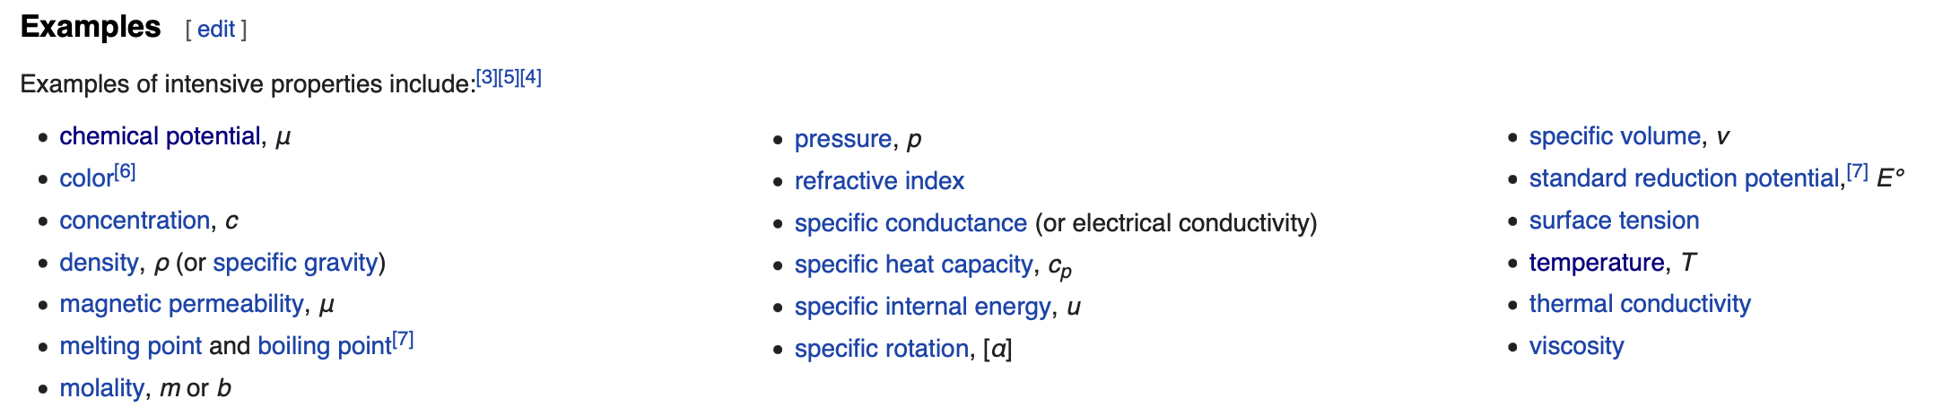
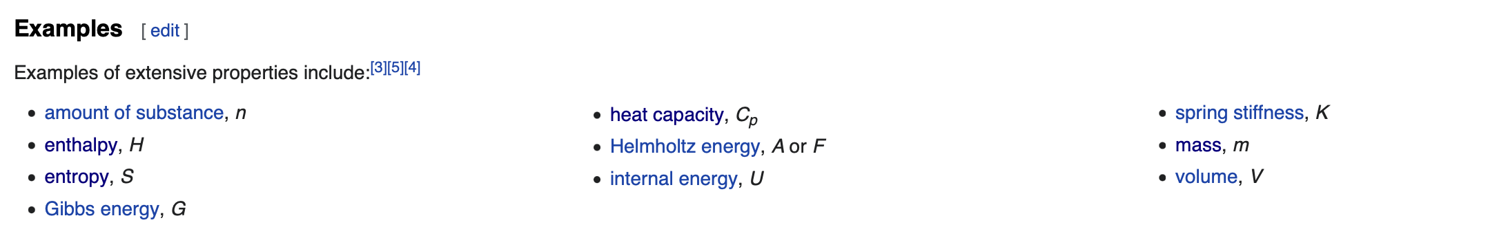
An intensive property does not depend on the system size or the amount of material in the system;
By contrast, extensive properties are additive for subsystems.

Slide 23

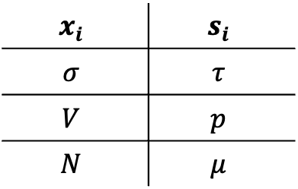
In a thermodynamic system, transfers of extensive quantities are associated with changes in respective specific intensive quantities. For example, a volume transfer is associated with a change in pressure. An entropy change is associated with a temperature change. A change of amount of electric polarization is associated with an electric field change. The transferred extensive quantities and their associated respective intensive quantities have dimensions that multiply to give the dimensions of energy. The two members of such respective specific pairs are mutually conjugate. Either one, but not both, of a conjugate pair may be set up as an independent state variable of a thermodynamic system. Conjugate setups are associated by Legendre transformations.
$$U=U\left(x_{1},x_{2}, …,x_{n}\right)$$
$$s_{i}=\frac{∂ U}{∂ x_{i}}$$
$\left(x_{i},s_{i}\right)=(extensive,intensive)$ 共轭
$$x_{i}$$ | $$s_{i}$$
$$σ$$ | $$τ$$
$$V$$ | $$p$$
$$N$$ | $$μ$$
$$F\left(τ\right)=U\left(σ\right)−στ$$
$$F\left(τ,?,?\right)=U\left(σ,V,N\right)−στ$$

Slide 24
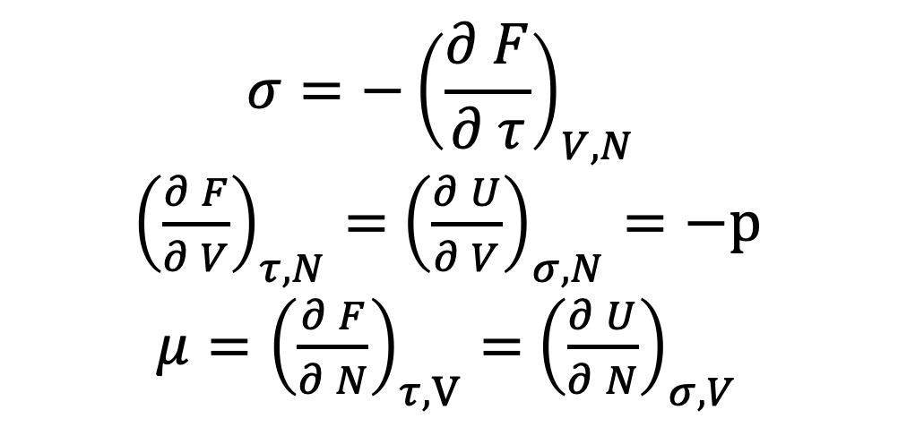
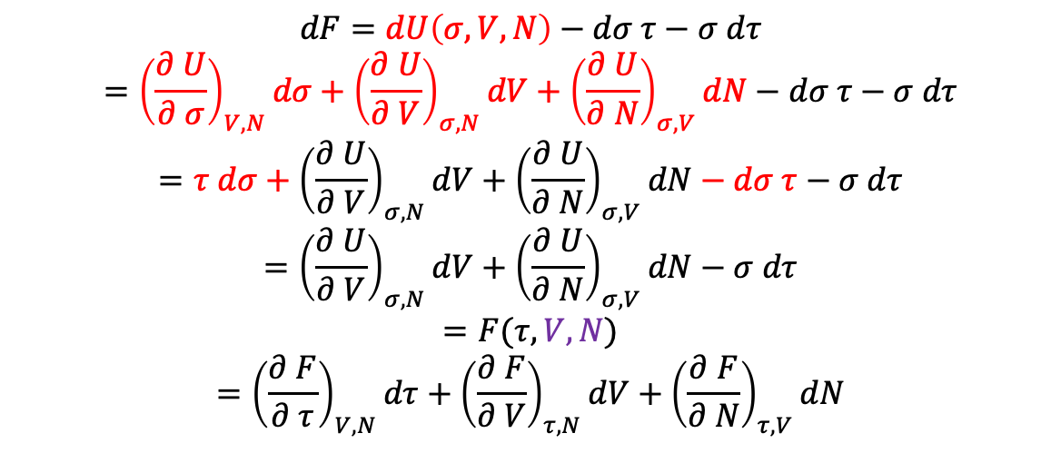
$$dF=dU\left(σ,V,N\right)−dσ τ−σ dτ$$
$$={\left(\frac{∂ U}{∂ σ}\right)}_{V,N}dσ+{\left(\frac{∂ U}{∂ V}\right)}_{σ,N}dV+{\left(\frac{∂ U}{∂ N}\right)}_{σ,V}dN−dσ τ−σ dτ$$
$$=τ dσ+{\left(\frac{∂ U}{∂ V}\right)}_{σ,N}dV+{\left(\frac{∂ U}{∂ N}\right)}_{σ,V}dN−dσ τ−σ dτ$$
$$={\left(\frac{∂ U}{∂ V}\right)}_{σ,N}dV+{\left(\frac{∂ U}{∂ N}\right)}_{σ,V}dN−σ dτ$$
$$=F(τ,V,N)$$
$$={\left(\frac{∂ F}{∂ τ}\right)}_{V,N}dτ+{\left(\frac{∂ F}{∂ V}\right)}_{τ,N}dV+{\left(\frac{∂ F}{∂ N}\right)}_{τ,V}dN$$
$${σ=−\left(\frac{∂ F}{∂ τ}\right)}_{V,N}$$
${\left(\frac{∂ F}{∂ V}\right)}_{τ,N}=$ ${\left(\frac{∂ U}{∂ V}\right)}_{σ,N}=−p$
${μ=\left(\frac{∂ F}{∂ N}\right)}_{τ,V}=$ ${\left(\frac{∂ U}{∂ N}\right)}_{σ,V}$
V and N 在这次Legendre变换中是旁观者

Slide 25
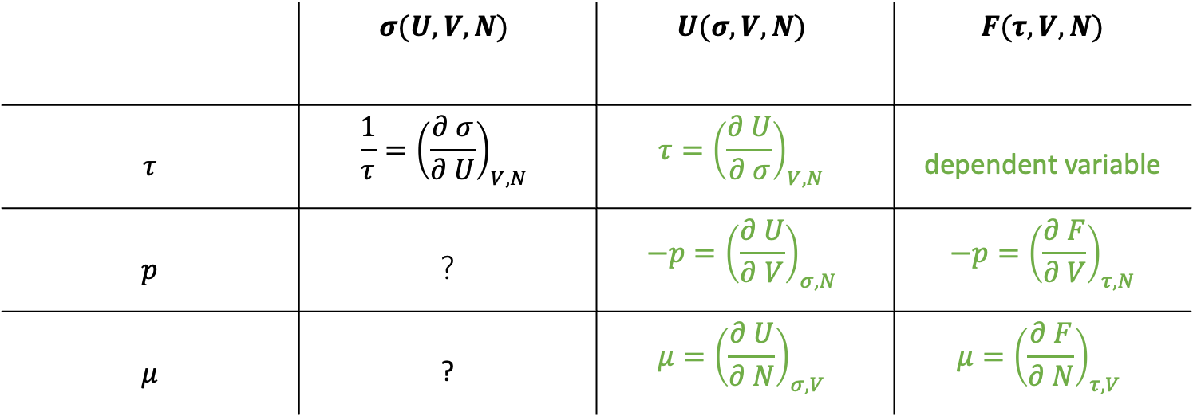
 | $$σ(U,V,N)$$ | $$U(σ,V,N)$$ | $$F(τ,V,N)$$
$$τ$$ | $$\frac{1}{τ}={\left(\frac{∂ σ}{∂ U}\right)}_{V,N}$$ | $$τ={\left(\frac{∂ U}{∂ σ}\right)}_{V,N}$$ | dependent variable
$$p$$ | $$？$$ | $$−p={\left(\frac{∂ U}{∂ V}\right)}_{σ,N}$$ | $$−p={\left(\frac{∂ F}{∂ V}\right)}_{τ,N}$$
$$μ$$ | ? | $$μ={\left(\frac{∂ U}{∂ N}\right)}_{σ,V}$$ | $$μ={\left(\frac{∂ F}{∂ N}\right)}_{τ,V}$$
Step-I：Legendre变换
Note: the chemical potential is the amount by which a system’s energy changes, when you add one particle and keep the entropy and volume fixed. Normally, to hold the entropy(multiplicity) fixed, you must remove some energy as you add a particle, so mu is negative.

Slide 26
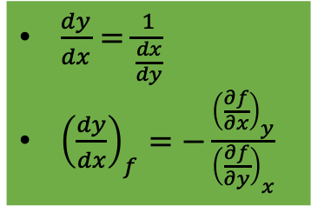
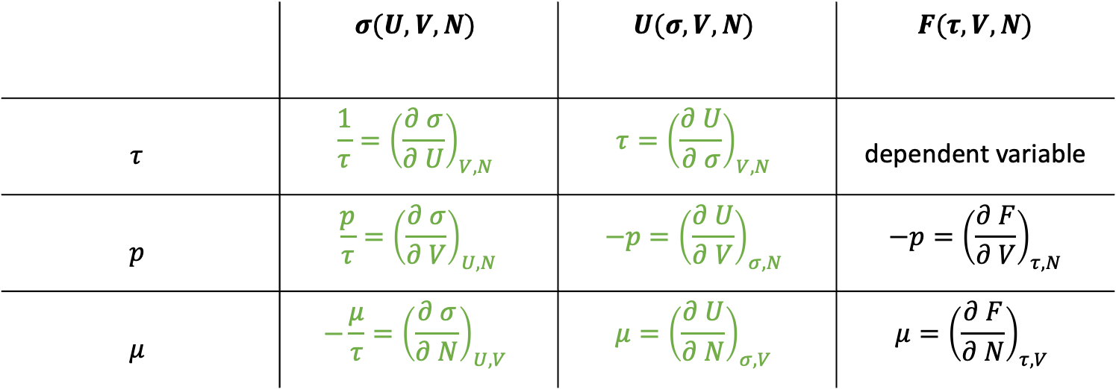
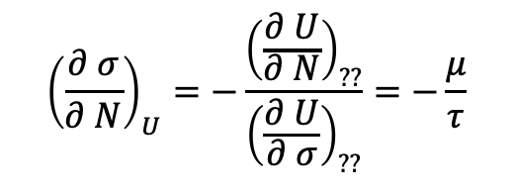
 | $$σ(U,V,N)$$ | $$U(σ,V,N)$$ | $$F(τ,V,N)$$
$$τ$$ | $$\frac{1}{τ}={\left(\frac{∂ σ}{∂ U}\right)}_{V,N}$$ | $$τ={\left(\frac{∂ U}{∂ σ}\right)}_{V,N}$$ | dependent variable
$$p$$ | $$\frac{p}{τ}={\left(\frac{∂ σ}{∂ V}\right)}_{U,N}$$ | $$−p={\left(\frac{∂ U}{∂ V}\right)}_{σ,N}$$ | $$−p={\left(\frac{∂ F}{∂ V}\right)}_{τ,N}$$
$$μ$$ | $$−\frac{μ}{τ}={\left(\frac{∂ σ}{∂ N}\right)}_{U,V}$$ | $$μ={\left(\frac{∂ U}{∂ N}\right)}_{σ,V}$$ | $$μ={\left(\frac{∂ F}{∂ N}\right)}_{τ,V}$$
$\frac{dy}{dx}=\frac{1}{\frac{dx}{dy}}$
${\left(\frac{dy}{dx}\right)}_{f}=−\frac{{\left(\frac{∂f}{∂x}\right)}_{y}}{{\left(\frac{∂f}{∂y}\right)}_{x}}$
Step-II:两个基本数学关系
$${\left(\frac{∂ σ}{∂ N}\right)}_{U}=−\frac{{\left(\frac{∂ U}{∂ N}\right)}_{??}}{{\left(\frac{∂ U}{∂ σ}\right)}_{??}}=−\frac{μ}{τ}$$

Slide 27
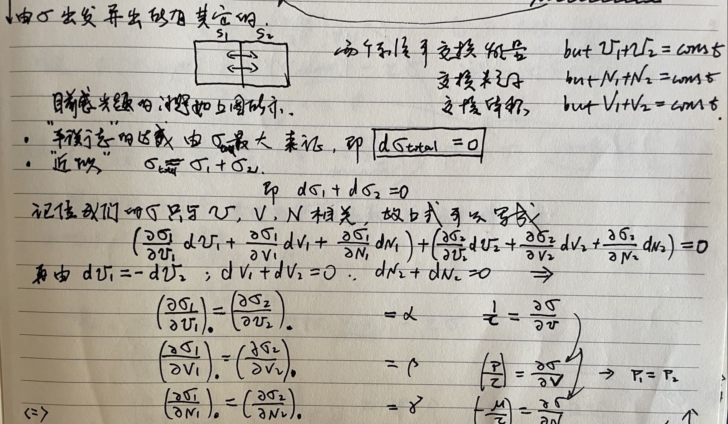
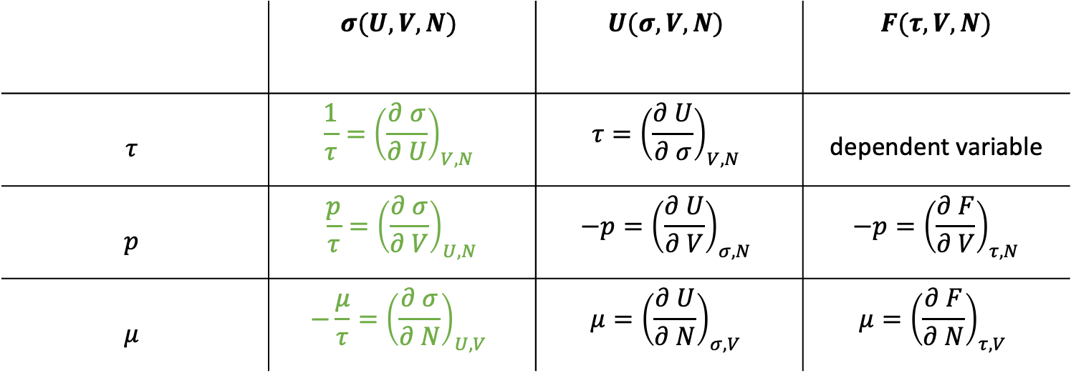
 | $$σ(U,V,N)$$ | $$U(σ,V,N)$$ | $$F(τ,V,N)$$
$$τ$$ | $$\frac{1}{τ}={\left(\frac{∂ σ}{∂ U}\right)}_{V,N}$$ | $$τ={\left(\frac{∂ U}{∂ σ}\right)}_{V,N}$$ | dependent variable
$$p$$ | $$\frac{p}{τ}={\left(\frac{∂ σ}{∂ V}\right)}_{U,N}$$ | $$−p={\left(\frac{∂ U}{∂ V}\right)}_{σ,N}$$ | $$−p={\left(\frac{∂ F}{∂ V}\right)}_{τ,N}$$
$$μ$$ | $$−\frac{μ}{τ}={\left(\frac{∂ σ}{∂ N}\right)}_{U,V}$$ | $$μ={\left(\frac{∂ U}{∂ N}\right)}_{σ,V}$$ | $$μ={\left(\frac{∂ F}{∂ N}\right)}_{τ,V}$$
另外一条途径(thermal/mechanical/diffusive equilibrium)

Slide 28

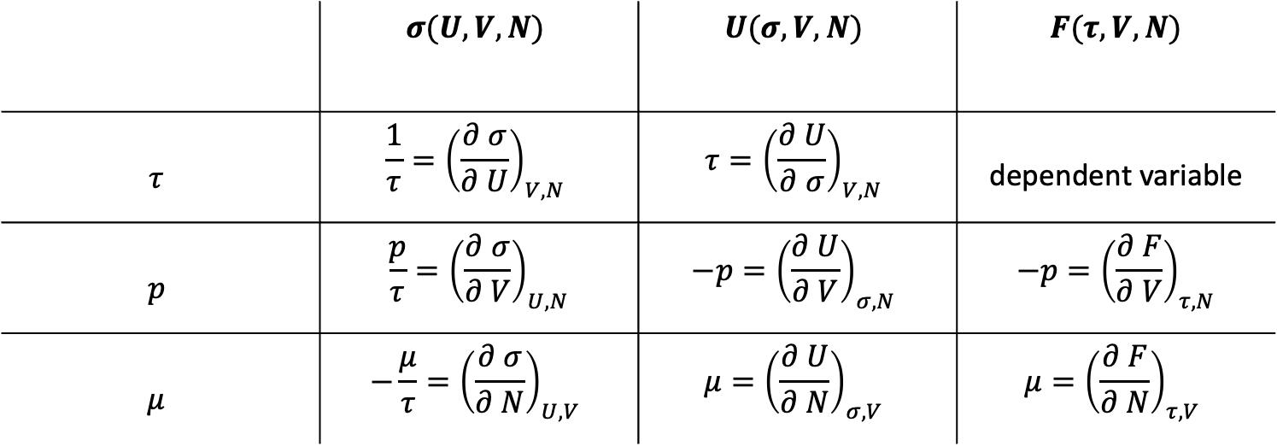
 | $$σ(U,V,N)$$ | $$U(σ,V,N)$$ | $$F(τ,V,N)$$
$$τ$$ | $$\frac{1}{τ}={\left(\frac{∂ σ}{∂ U}\right)}_{V,N}$$ | $$τ={\left(\frac{∂ U}{∂ σ}\right)}_{V,N}$$ | dependent variable
$$p$$ | $$\frac{p}{τ}={\left(\frac{∂ σ}{∂ V}\right)}_{U,N}$$ | $$−p={\left(\frac{∂ U}{∂ V}\right)}_{σ,N}$$ | $$−p={\left(\frac{∂ F}{∂ V}\right)}_{τ,N}$$
$$μ$$ | $$−\frac{μ}{τ}={\left(\frac{∂ σ}{∂ N}\right)}_{U,V}$$ | $$μ={\left(\frac{∂ U}{∂ N}\right)}_{σ,V}$$ | $$μ={\left(\frac{∂ F}{∂ N}\right)}_{τ,V}$$
Thermodynamic identity
$$dU=τdσ−pdV+μdN$$
Chemical Work

Slide 29


 | $$σ(U,V,N)$$ | $$U(σ,V,N)$$ | $$F(τ,V,N)$$
$$τ$$ | $$\frac{1}{τ}={\left(\frac{∂ σ}{∂ U}\right)}_{V,N}$$ | $$τ={\left(\frac{∂ U}{∂ σ}\right)}_{V,N}$$ | dependent variable
$$p$$ | $$\frac{p}{τ}={\left(\frac{∂ σ}{∂ V}\right)}_{U,N}$$ | $$−p={\left(\frac{∂ U}{∂ V}\right)}_{σ,N}$$ | $$−p={\left(\frac{∂ F}{∂ V}\right)}_{τ,N}$$
$$μ$$ | $$−\frac{μ}{τ}={\left(\frac{∂ σ}{∂ N}\right)}_{U,V}$$ | $$μ={\left(\frac{∂ U}{∂ N}\right)}_{σ,V}$$ | $$μ={\left(\frac{∂ F}{∂ N}\right)}_{τ,V}$$
$$dU=τdσ−pdV+μdN$$
Fixed U and V, $0=τdσ+μdN, that is, −\frac{μ}{τ}={\left(\frac{∂σ}{∂N}\right)}_{U,V}$
Fixed $σ$ and V, $dU=μ dN, that is, μ={\left(\frac{∂U}{∂N}\right)}_{σ,V}$

Slide 30
$$n_{Q}={\left(\frac{m τ}{2πℏ^{2}}\right)}^{3/2}$$
理想气体的化学势
$$F=τ(N\log{N−N−N\log{n_{Q}V}})$$
$$μ=τ\log{\frac{n}{n_{Q}}}$$
$$σ=N (\log{\frac{n_{Q}}{n}+\frac{5}{2}})$$
2022.03.20

Slide 31
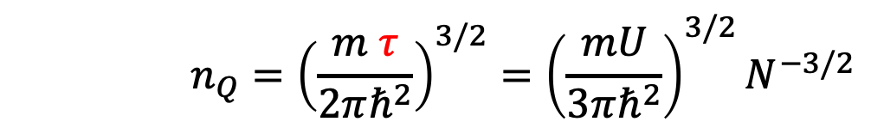

理想气体的化学势
$$μ=τ\log{\frac{n}{n_{Q}}}$$
$$n_{Q}={\left(\frac{m τ}{2πℏ^{2}}\right)}^{3/2}={\left(\frac{mU}{3πℏ^{2}}\right)}^{3/2}N^{−3/2}$$
$$σ=N (\log{\frac{n_{Q}}{n}+\frac{5}{2}})$$

Slide 32

补遗一：Statistical independence(Landau)
The fact that different subsystems may be regarded as weakly interacting has the result that they may also be regarded as statistically independent. By statistical independence we mean that the state of one subsystem does not affect the probabilities of various states of the other subsystems.
(Quasi-closed)
$$σ≈σ_{1}+σ_{2}$$
$$F≈F_{1}+F_{2}$$

Slide 33
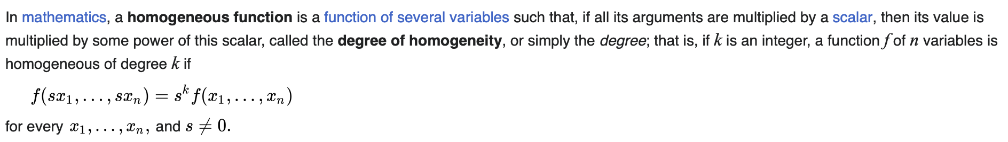

补遗二：An additive thermodynamic quantity must be a homogeneous function of the first order with respect to the additive variables.
$$U=N f\left(\frac{σ}{N},\frac{V}{N}\right)$$
$$F=N f\left(\frac{V}{N},τ\right)$$
$$G=N f\left(p,τ\right)$$

Slide 34

补遗二：An additive thermodynamic quantity must be a homogeneous function of the first order with respect to the additive variables.
$$U=N f\left(\frac{σ}{N},\frac{V}{N}\right)$$
$$F=N f\left(\frac{V}{N},τ\right)$$
$$G=N f\left(p,τ\right)$$

Slide 35





补遗三
 | $$σ(U,V,N)$$ | $$U(σ,V,N)$$ | $$F(τ,V,N)$$ | $$G(τ,p,N)$$
$$τ$$ | $$\frac{1}{τ}={\left(\frac{∂ σ}{∂ U}\right)}_{V,N}$$ | $$τ={\left(\frac{∂ U}{∂ σ}\right)}_{V,N}$$ | $${σ=−\left(\frac{∂ F}{∂ τ}\right)}_{V,N}$$ | $$σ=−{\left(\frac{∂ G}{∂ τ}\right)}_{p,N}$$
$$p$$ | $$\frac{p}{τ}={\left(\frac{∂ σ}{∂ V}\right)}_{U,N}$$ | $$−p={\left(\frac{∂ U}{∂ V}\right)}_{σ,N}$$ | $$−p={\left(\frac{∂ F}{∂ V}\right)}_{τ,N}$$ | $$V={\left(\frac{∂ G}{∂ p}\right)}_{τ,N}$$
$$μ$$ | $$−\frac{μ}{τ}={\left(\frac{∂ σ}{∂ N}\right)}_{U,V}$$ | $$μ={\left(\frac{∂ U}{∂ N}\right)}_{σ,V}$$ | $$μ={\left(\frac{∂ F}{∂ N}\right)}_{τ,V}$$ | $$μ={\left(\frac{∂ G}{∂ N}\right)}_{τ,p}$$
Gibbs Free Energy(Landau: thermodynamical potential) $G(τ,p,N)=U−στ+pV$
$$dG=−σdτ+Vdp+\sum_{i}{μ_{i}dN_{i}}$$
$$G=\sum_{i}{N_{i}μ_{i}}$$
Consider a fixed amount of gas at a fixed temperature, as we vary the pressure
$$\frac{∂ μ}{∂ p}=\frac{1}{N}\frac{∂G}{∂ p}=\frac{V}{N} = \frac{τ}{p}$$
$$μ\left(τ,p\right)−μ\left(τ,p_{0}\right)=τ\log{\frac{p}{p_{0}}}????$$

Slide 36



补遗四
 | $$σ(U,V,N)$$ | $$U(σ,V,N)$$ | $$F(τ,V,N)$$ | $$G(τ,p,N)$$ | $$Ω(τ,V,μ)$$
$$τ$$ | $$\frac{1}{τ}={\left(\frac{∂ σ}{∂ U}\right)}_{V,N}$$ | $$τ={\left(\frac{∂ U}{∂ σ}\right)}_{V,N}$$ | dependent variable | $$σ=−{\left(\frac{∂ G}{∂ τ}\right)}_{p,N}$$
$$p$$ | $$\frac{p}{τ}={\left(\frac{∂ σ}{∂ V}\right)}_{U,N}$$ | $$−p={\left(\frac{∂ U}{∂ V}\right)}_{σ,N}$$ | $$−p={\left(\frac{∂ F}{∂ V}\right)}_{τ,N}$$ | $$V={\left(\frac{∂ G}{∂ p}\right)}_{τ,N}$$ | $$−p={\left(\frac{∂ Ω}{∂ V}\right)}_{τ,μ}$$
$$μ$$ | $$−\frac{μ}{τ}={\left(\frac{∂ σ}{∂ N}\right)}_{U,V}$$ | $$μ={\left(\frac{∂ U}{∂ N}\right)}_{σ,V}$$ | $$μ={\left(\frac{∂ F}{∂ N}\right)}_{τ,V}$$ | $$μ={\left(\frac{∂ G}{∂ N}\right)}_{τ,p}$$
Grand Free Energy $Ω\left(τ,V,μ\right)=U−στ−μN$
$$Ω=pV$$
$$σ=−{\left(\frac{∂Ω}{∂τ}\right)}_{V,μ},N=−{\left(\frac{∂Ω}{∂μ}\right)}_{τ,V}$$

Slide 37


补遗五：雅可比行列式（纯粹为了玩儿！！！）
设变量u和v是独立变量x和y的函数，即$u=u\left(x,y\right), v=v\left(x,y\right)$，则可以定义如下雅可比行列式
$$\frac{∂ (u,v)}{∂ (x,y)}=\left|\begin{matrix}{\left(\frac{∂ u}{∂ x}\right)}_{y} & {\left(\frac{∂ u}{∂ y}\right)}_{x} \\ {\left(\frac{∂ v}{∂ x}\right)}_{y} & {\left(\frac{∂ v}{∂ y}\right)}_{x}\end{matrix}\right|$$
可以证明
$${\left(\frac{∂ u}{∂ x}\right)}_{y}=\frac{∂ (u,y)}{∂ (x,y)}$$
若s和t也是x和y的函数，则有
$$\frac{∂ (u,v)}{∂ (x,y)}=\frac{∂ (u,v)}{∂ (s,t)}\frac{∂ (s,t)}{∂ (x,y)}$$

Slide 38


补遗五☹Landau: Derive an expression for the specific heat Cv in terms of the variables $τ,V,μ$
$${C_{V}=τ\left(\frac{∂ σ}{∂ τ}\right)}_{V,N}$$
${\left(\frac{∂ σ}{∂ τ}\right)}_{N}=\frac{∂ (σ,N)}{∂ (τ,N)}=$ $\frac{∂ (σ,N)}{∂ (τ,μ)}$ $\frac{∂ (τ,μ)}{∂ (τ,N)}=$ $\left|\begin{matrix}{\left(\frac{∂ σ}{∂ τ}\right)}_{μ} & {\left(\frac{∂ σ}{∂ μ}\right)}_{τ} \\ {\left(\frac{∂ N}{∂ τ}\right)}_{μ} & {\left(\frac{∂ N}{∂ μ}\right)}_{τ}\end{matrix}\right|$ $\left({\left(\frac{∂ μ}{∂ N}\right)}_{τ}\right)$
$=\left({\left(\frac{∂ σ}{∂ τ}\right)}_{μ}{\left(\frac{∂ N}{∂ μ}\right)}_{τ}−{\left(\frac{∂ N}{∂ τ}\right)}_{μ}{\left(\frac{∂ σ}{∂ μ}\right)}_{τ}\right)$ $\left({\left(\frac{∂ μ}{∂ N}\right)}_{τ}\right)$
$=$ ${\left(\frac{∂ σ}{∂ τ}\right)}_{μ}−\frac{{\left(∂σ/∂μ\right)}_{τ}{\left(∂N/∂τ\right)}_{μ}}{{\left(∂N/∂μ\right)}_{τ}}$
But ${\left(∂σ/∂μ\right)}_{τ}=−\frac{∂^{2}Ω}{∂τ∂μ}={\left(∂N/∂τ\right)}_{μ}$
$$C_{V}=τ({\left(\frac{∂ σ}{∂ τ}\right)}_{μ}−\frac{{\left[{\left(∂N/∂τ\right)}_{μ}\right]}^{2}}{{\left(∂N/∂μ\right)}_{τ}})$$

Slide 39

补遗六
假设我们有一个系统，其单粒子能级为$ε_{i}$。对此系统外加一个势能E₀，那么新的能级为$E_{0}+ε_{i}$
配分函数
$$Z^{′}=\sum_{i}{e^{−\frac{E_{0}+ε_{i}}{τ}}}=e^{−\frac{E_{0}}{τ}} Z$$
H自由能
$$F^{′}=−τ\log{Z^{′}=E_{0}−τ\log{Z=E_{0}+F}}$$
对N个粒子
$$F^{′}=−Nτ\log{Z+N E_{0}}$$
化学势
$$μ^{′}={\left(\frac{∂ F′}{∂ N}\right)}_{τ,V}=μ+E_{0}$$

Slide 40

补遗六
假设我们有一个系统，其单粒子能级为$ε_{i}$。对此系统外加一个势能E₀，那么新的能级为$E_{0}+ε_{i}$
配分函数
$$Z^{′}=\sum_{i}{e^{−\frac{E_{0}+ε_{i}}{τ}}}=e^{−\frac{E_{0}}{τ}} Z$$
H自由能
$$F^{′}=−τ\log{Z^{′}=E_{0}−τ\log{Z=E_{0}+F}}$$
对N个粒子
$$F^{′}=−Nτ\log{Z+N E_{0}}$$
化学势
$$μ^{′}={\left(\frac{∂ F′}{∂ N}\right)}_{τ,V}=μ+E_{0}$$
Adding a potential energy per particle therefore corresponds to adding a potential energy to the chemical potential.
$$μ_{total}=μ_{ext}+μ_{int}$$

Slide 41



Let us look at two system A and B at the same temperature that may exchange particles. Assume $μ_{B}>μ_{A}$, $∆μ=μ_{B}−μ_{A}$.
Let us now introduce a difference in potential energy between the two systems. For example, for charged particles we may introduce an electric field with a voltage diffeerence $∆V$. We apply this to all particles in system A so that we raise their potential energy by $∆μ$.
$$q∆V=∆μ$$
We have not changed $U_{B} and F_{B}$
The change in free energy in system A is by the change in internal energy, $U_{A}=N_{A} q∆V…$this means that the energy of every state in system A has changed by $q∆V$
补遗六
$μ_{A}\left(final\right)=μ_{A}\left(initial\right)+q∆V=μ_{A}\left(initial\right)+∆μ=μ_{A}\left(initial\right)+\left(μ_{B}\left(initial\right)−μ_{A}\left(initial\right)\right)=μ_{B}\left(initial\right)$= $μ_{B}\left(final\right)$
There is therefore no longer any difference in chemical potential.
化学势的意义
The chemical poential is equivalent to a true potential energy: the difference in chemical potential between two system is equal to the potential barrier that will bring the two system into difffusive equilibrium.
$$μ_{B}$$
$$μ_{A}$$

Slide 42


一个例子：Barometric pressure formula
假设地球大气层处于恒温tau
The potential energy of a gas particle would be mgz, where we may place the zero in potential energy at the Earths surface.
The total chemical potential
$$μ=τ\log{\frac{n}{n_{Q}}+mgz}$$
In equilibrium there should be no differences in chemical potential
$$τ\log{\frac{n(z)}{n_{Q}}+mgz=}τ\log{\frac{n(0)}{n_{Q}}}$$
which gives
$$n\left(z\right)=n(0)e^{−mgz/τ}$$
$pV=Nτ →p=n τ$
$p\left(z\right)=p\left(0\right)e^{−mgh/τ}$

Slide 43



正反夸克成对产生/湮灭，正反夸克的数目差固定
$$N_{+}−N_{−}=0$$
$∆N_{+}=∆N_{−}$
$dF=0, μ_{+}+μ_{−}=0$
考虑相对论情形
$E≈m_{0}c^{2}+\frac{p^{2}}{2m}$
$μ=$ $m_{0}c^{2}$+$τ\log{\frac{n}{n_{Q}}}$

Slide 44

Landau

Slide 45

一个例子：Magnetic field(刘博达)
2022.03.29

Slide 46
Gibbs Sum = grand partition function
How can we treat systems where the number of particles may change from a microscopic point of view.

Slide 47






系统和热库之间可以交换能量和粒子
$$τ,μ$$
Reservoir
$$ℛ$$
System
$$𝒮$$
N(any number)个粒子，N个例子能量为$ε_{S}{=ε}_{S(N)}$
假设我们已经完全指定了系统的状态，那么此时系统+热库的Multiplicity
$$g\left(ℛ+𝒮\right)=g(ℛ)×1$$
$$g\left(ℛ\right)=g(N_{0}−N,U_{0}−ε_{s})$$

Slide 48






Probability of the system to be in this specified state
$$P\left(s\right)∝g\left(ℛ\right)=g(N_{0}−N,U_{0}−ε_{s})$$
Reservoir
$$ℛ$$
$$N_{0}−N_{1}$$
$$U_{0}−ε_{1}$$
$$g(N_{0}−N_{1},U_{0}−ε_{1})$$
Reservoir
$$ℛ$$
$$N_{0}−N_{2}$$
$$U_{0}−ε_{2}$$
$$g(N_{0}−N_{2},U_{0}−ε_{2})$$
System
$$𝒮(N_{1},ε_{1})$$
System
$$𝒮(N_{2},ε_{2})$$
指定两个不同的态，其概率比值为
$$\frac{P(s_{1})}{P(s_{2})}=\frac{g(N_{0}−N_{1},U_{0}−ε_{1})}{g(N_{0}−N_{2},U_{0}−ε_{2})}$$

Slide 49



$$\frac{P(s_{1})}{P(s_{2})}=\frac{g(N_{0}−N_{1},U_{0}−ε_{1})}{g(N_{0}−N_{2},U_{0}−ε_{2})}=\frac{e^{σ(N_{0}−N_{1},U_{0}−ε_{1})}}{e^{σ(N_{0}−N_{2},U_{0}−ε_{2})}}$$
$$=e^{σ\left(N_{0}−N_{1},U_{0}−ε_{1}\right)−σ(N_{0}−N_{2},U_{0}−ε_{2})}≡e^{∆σ}$$
Taylor
$$σ\left(N_{0}−N,U_{0}−ε\right)≈σ\left(N_{0},U_{0}\right)−N{\left(\frac{∂σ}{∂N_{0}}\right)}_{U_{0}}−ε{\left(\frac{∂σ}{∂U_{0}}\right)}_{N_{0}}…$$
$$∆σ≈−\left(N_{1}−N_{2}\right){\left(\frac{∂σ}{∂N_{0}}\right)}_{U_{0}}−\left(ε_{1}−ε_{2}\right){\left(\frac{∂σ}{∂U_{0}}\right)}_{N_{0}}…$$

Slide 50


$$\frac{P(s_{1})}{P(s_{2})}=e^{∆σ}≈e^{−\left(N_{1}−N_{2}\right){\left(\frac{∂σ}{∂N_{0}}\right)}_{U_{0}}−\left(ε_{1}−ε_{2}\right){\left(\frac{∂σ}{∂U_{0}}\right)}_{N_{0}}…}$$
$$=e^{\left(N_{1}−N_{2}\right)\frac{μ}{τ} −\left(ε_{1}−ε_{2}\right)\frac{1}{τ}…}$$
$$=\frac{e^{(N_{1}μ−ε_{1})/τ}}{e^{(N_{2}μ−ε_{2})/τ}}$$
Gibbs Factor!
$$e^{(Nμ−ε_{s(N)})/τ}$$

Slide 51



Gibbs Sum=Grand Partition Function
Sum over Gibbs Factors
$$𝒵\left(μ,τ\right)=\sum_{N=0}^{∞}{\sum_{s(N)}{e^{(Nμ−ε_{s(N)})/τ}}=\sum_{ASN}{e^{(Nμ−ε_{s(N)})/τ}}}$$
All States and Numbers
Probability of having N particles, and being in the state “s”
$$P\left(N,s\right)=\frac{e^{(Nμ−ε_{s(N)})/τ}}{𝒵}$$
normalized
$$\sum_{ASN}{P\left(N,s\right)=\sum_{ASN}{\frac{e^{(Nμ−ε_{s(N)})/τ}}{𝒵}}}=\frac{𝒵}{𝒵}=1$$

Slide 52

平均值：A average values over the system in diffusive and thermal contact with a reserioir
$$\left\langle X\right\rangle =\sum_{ASN}{X\left(N,ε\right)P(N,ε)}$$
Notice that both the energy and the number of particles now are fluctuating quantities!!
Average number of particles
$$\left\langle N\right\rangle =\frac{1}{𝒵}\sum_{ANS}{N e^{\frac{Nμ−ε}{τ}}}$$
$$=\frac{1}{𝒵}\sum_{ANS}{τ\frac{d}{d μ} e^{\frac{Nμ−ε}{τ}}}$$
$$=\frac{1}{𝒵}τ\frac{d}{d μ}\sum_{ANS}{ e^{\frac{Nμ−ε}{τ}}}$$
$$=τ\frac{d}{d μ}\log{𝒵}$$
Average energy of particles
$$U=\left\langle ε\right\rangle =\left(\frac{μ}{β}\frac{∂}{∂ μ}−\frac{∂}{∂ β}\right)\log{𝒵}$$

Slide 53


Absolute activity
$$λ≡e^{μ/τ}$$
For ideal gas $λ=\frac{n}{n_{Q}}←μ=τ\log{\frac{n}{n_{Q}}}$
Gibbs Sum $𝒵\left(μ,τ\right)=\sum_{ASN}{λ^{N}e^{−ε/τ}}$
Average number $\left\langle N\right\rangle =λ\frac{∂}{∂λ}\log{𝒵}$
Energy $U=\left\langle ε\right\rangle =\left(μλ\frac{∂}{∂λ}−\frac{∂}{∂ β}\right)\log{𝒵}$
$$−\frac{∂}{∂β}\log{𝒵=\left\langle ε−Nμ\right\rangle =U−Nμ}$$

Slide 54





U,V,N fixed
$τ$,V,N fixed
$τ$,V,$μ$ fixed
$$τ$$
$$τ,μ$$
Factor 1${ e}^{−ε/τ}$ ${ e}^{(Nμ−ε)/τ}=λ^{N}e^{−ε/τ}$
配分函数
$g=\sum{}$ $Z=\sum_{s}{}$ $𝒵=\sum_{ASN}{}$
极值
$σ=\log{g}$ $F=−τ\log{Z}$ $Ω=−τ\log{𝒵}$
Legendre变换
$F=U−στ$ $Ω=U−στ−Nμ$

Slide 55

$$σ=σ_{R}\left(U−U_{s},N−N_{s}\right)+σ_{S}$$
$$≈σ_{R}\left(U,N\right)−\left(\right)U_{s}−\left(\right)N_{s}+σ_{S}$$

Slide 56





$F=U−σ τ=U+τ\left(\frac{∂ F}{∂ τ}\right)$。 V fixed
$$U→U−Nμ$$
$U=F−τ$ $\left(\frac{∂ F}{∂ τ}\right)=−τ^{2}\left(−\frac{F}{τ^{2}}+\frac{1}{τ}\frac{∂ F}{∂ τ}\right)=−τ^{2}\frac{∂\frac{F}{τ}}{∂ τ}$
另外我们知道 $U=τ^{2} \frac{∂\log{Z}}{∂ τ}$
$$\frac{F}{τ}+\log{Z=const}$$
由于const和温度无关，我们可以利用零温这个特殊情况把const定下来
$F_{τ→0}→U_{0}−τ\log{g_{0}}$
$Z={g_{0} e}^{−U_{0}/τ}+g_{1} e^{−U_{1}/τ}+…\underset{→}{τ→0} g_{0} e^{−U_{0}/τ}$ $τ\log{Z=τ\log{g_{0}−U_{0}}}$
Const=0
F=$−τ\log{Z}$

Slide 57

In order to obtain the thermodynamic properties of our system in contact with a heat and particle reservioir, we do the following:
1, calculate the grand partition function
2, calculate the grand free energy
3, calculat the remaining thermodynamic properties through the equations:
$$σ=−{\left(\frac{∂Ω}{∂τ}\right)}_{V,μ},N=−{\left(\frac{∂Ω}{∂μ}\right)}_{τ,V},−p={\left(\frac{∂ Ω}{∂ V}\right)}_{τ,μ}$$

Slide 58


回到吸收
把目光放在某个site上
For the site 1, there are two states;
Unoccupied Occupied
Number: 0 1
Energy: 0 $−ε_{0}$
Gibbs factor: 1 $λe^{ε_{0}/τ}$
Gibbs sum is
$$Z_{G}=1+λe^{ε_{0}/τ}$$
The probability for an atom in the occupied state is
$$\frac{0+λe^{ε_{0}/τ}}{1+λe^{ε_{0}/τ}}$$

Slide 59

理想气体 ideal gas(fixed temperature and chemical potential)
正则配分函数
$Z_{N}\left(τ,V\right)=\frac{1}{N!} {\left(n_{Q}V\right)}^{N}$
巨配分函数
$$Z=\sum_{N=0}^{∞}{λ^{N}}Z_{N}\left(τ,V\right)=\sum_{N=0}^{∞}{\frac{1}{N!}{\left(n_{Q}V e^{μ/τ}\right)}^{N}=e^{n_{Q}V e^{μ/τ}}}$$
巨势
$$Ω(τ,V,μ)=−τ\log{Z=−τn_{Q}V e^{μ/τ}}$$
粒子数
$N=−{\left(\frac{∂Ω}{∂μ}\right)}_{τ,V}=n_{Q}V e^{μ/τ}$. Omega=-tau N
能量
$U=\left(\frac{μ}{β}\frac{∂}{∂ μ}−\frac{∂}{∂ β}\right)\log{𝒵}=\frac{3}{2}τ$ $n_{Q}V e^{μ/τ}=\frac{3}{2} Nτ$
压强
$$p=−{\left(\frac{∂ Ω}{∂ V}\right)}_{τ,μ}=\frac{N}{V}τ$$
熵
$$σ=−{\left(\frac{∂Ω}{∂τ}\right)}_{V,μ}=−\frac{Ω}{τ}\left(\frac{5}{2}−\frac{μ}{τ}\right)=…$$

Slide 60




$$C_{V}=τ({\left(\frac{∂ σ}{∂ τ}\right)}_{μ}−\frac{{\left[{\left(∂N/∂τ\right)}_{μ}\right]}^{2}}{{\left(∂N/∂μ\right)}_{τ}})$$
已知道
$σ\left(τ,μ\right)=−\frac{Ω}{τ}\left(\frac{5}{2}−\frac{μ}{τ}\right)$=$n_{Q}V e^{μ/τ}\left(\frac{5}{2}−\frac{μ}{τ}\right)$
$$N\left(τ,μ\right)=n_{Q}V e^{μ/τ}$$
$$C_{V}=\frac{3}{2} n_{Q} Ve^{μ/τ}=\frac{3}{2}N$$

Slide 61

（N个sites，吸收N1个分子）
When N1 molecules are absorbed, the energy is equal to $−N_{1}ε_{0}$. The partition function
$$Z_{c}\left(N_{1}\right)=\frac{N!}{N_{1}!\left(N−N_{1}\right)!}e^{β{(N}_{1}ε_{0}+N_{1}μ)}$$
Suppose x= $e^{β(ε_{0}+μ)}$.
Total partion function
$$Z_{G}=\sum_{N_{1}=0}^{N}{\frac{N!}{N_{1}!\left(N−N_{1}\right)!}e^{β{(N}_{1}ε_{0}+N_{1}μ)}}$$
$$=\sum_{N_{1}}^{N}{\frac{N!}{N_{1}!\left(N−N_{1}\right)!}{\left(x\right)}^{N_{1}}}$$
$$={\left(1+x\right)}^{N}$$
The average number
$$\left\langle N_{1}\right\rangle =\frac{\sum_{N_{1}}^{N}{\left(N_{1}\right)\frac{N!}{N_{1}!\left(N−N_{1}\right)!}{\left(x\right)}^{N_{1}}}}{Z_{G}}=\frac{x\frac{∂}{∂x}Z_{G}}{Z_{G}}=N\frac{e^{β(ε_{0}+μ)}}{1+e^{β(ε_{0}+μ)}}$$

Slide 62
从此处说起（N个sites，吸收N1个分子）
When N1 molecules are absorbed, the energy is equal to $−N_{1}ε_{0}$. The partition function
$$Z_{c}\left(N_{1}\right)=\frac{N!}{N_{1}!\left(N−N_{1}\right)!}e^{β{(N}_{1}ε_{0}+N_{1}μ)}$$
Suppose x= $e^{β(ε_{0}+μ)}$.
Total partion function
$$Z_{G}=\sum_{N_{1}=0}^{N}{\frac{N!}{N_{1}!\left(N−N_{1}\right)!}e^{β{(N}_{1}ε_{0}+N_{1}μ)}}$$
$$=\sum_{N_{1}}^{N}{\frac{N!}{N_{1}!\left(N−N_{1}\right)!}{\left(x\right)}^{N_{1}}}$$
$$={\left(1+x\right)}^{N}$$
The average number
$$\left\langle N_{1}\right\rangle =\frac{\sum_{N_{1}}^{N}{\left(N_{1}\right)\frac{N!}{N_{1}!\left(N−N_{1}\right)!}{\left(x\right)}^{N_{1}}}}{Z_{G}}=\frac{x\frac{∂}{∂x}Z_{G}}{Z_{G}}=N\frac{e^{β(ε_{0}+μ)}}{1+e^{β(ε_{0}+μ)}}$$

